Slide 1
Homework #4
Creating a password generator
202339674 Zhou Zixuan

Slide 2
Project Overview
Create a program that can generate passwords，allows users to control the passwords:
1. Mix upper- and lower-case letters.
2. Ability to add numbers.
3. Ability to add other keyboard characters.
4. The number of characters in each category.
5. Passwords should be stronger and more secure

Slide 3
Requirements Planning Phase
Key Requirements
Users can set the length of the password.
Users can choose whether to include the following character types: uppercase letters, lowercase letters, numbers, special symbols.
The program can automatically generate a random password based on user settings.
If the user does not select any character type, the program should give an error message.

Slide 4
User Design Phase
Input design: let the user enter the password length and the character types required
Output design: generate a random password
Internal logic design: select a character pool, randomly extract characters, and combine them into a password

Slide 5
Rapid Construction Phase
Module | Status | Notes
Initialize the project file structure | Completed | For example, the module folder
Writing a basic input module | Completed | Support receiving password length and character type options
Constructing character pool logic | Completed | Add uppercase, lowercase, numbers, symbols as per your choice
Add the most basic exception judgment | Completed | Like no input, wrong format

Slide 6
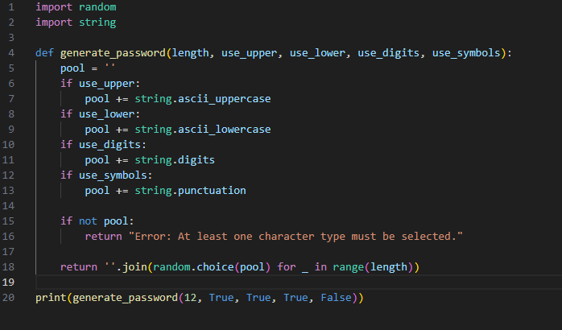
Implementation

Slide 7
Testing Phase
1. Check if the password is of the correct length
2. Check if it contains the character types required by the user
3. Check if different passwords are generated after multiple runs
4. Handle error conditions, such as prompting an error when no character type is selected

Slide 8
Deployment Phase
1. Run the code in the command
2. Make it into a graphical interface/web tool
3. share it with classmates or teachers

Slide 9
Maintenance Plan
Features that can be added later:
• Password strength assessment
• Exclude similar characters (such as I and 1)
• Save password history
Optimize based on user feedback

